Slide 3
Overview of Compilation.
Compiler Structure
Each phase is divided internally into a series of passes.
The front end consists of two or three passes that handle the details of recognizing valid source-language programs and producing the initial IR.
The middle section contains passes that perform different optimizations.
The back end consists of a series of passes, each of which takes the IR program one step closer to the target machine’s instruction set.

Slide 4
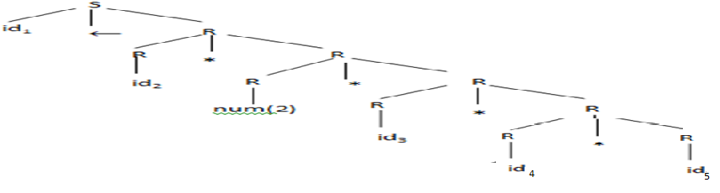
Overview of Compilation.
Overview of Translation
a←a * 2 * b * c * d
Scanner [Lexical Analyzer]
Stream of Tokens
<id,a><assign, ← > <id,a> <mul,*> <num,2> <mul,*> <id,b> <mul,*> <id,c> <mul,*> <id,d>
Parser [Syntax Analyzer]
Concrete Parse tree( CPT/ CST)

Slide 5
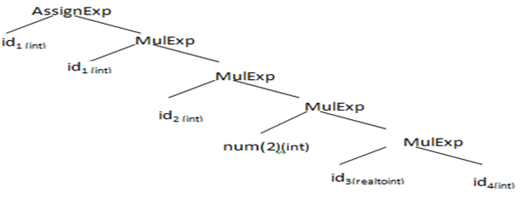
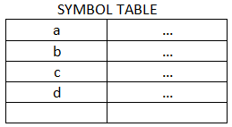
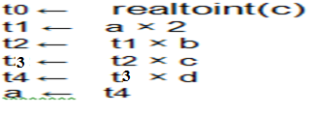
Overview of Compilation.
Overview of Translation
Annotated Abstract Syntax Tree (AST)
Semantic Elaboration [Semantic analyzer]
Semantic Elaboration
Intermediate Code Generator
Non-optimized Intermediate Representation

Slide 6
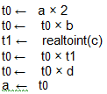
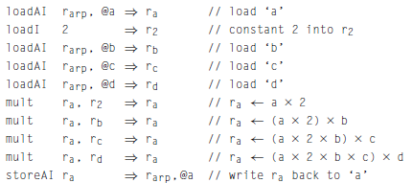
Overview of Compilation.
Overview of Translation
Code Optimizer
Optimized Intermediate Code with Symbolic registers
Instruction Selection
Target ILOC code with Virtual Registers

Slide 7
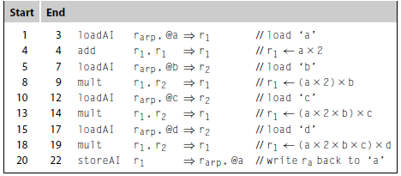
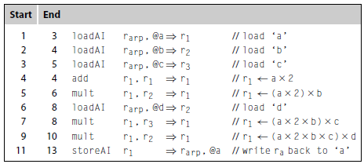
Overview of Compilation.
Overview of Translation
Register Allocation
Target ILOC code with Permanent Registers
Instruction Scheduling
Optimized Target ILOC code with Permanent Registers

Slide 8
Another Example

Slide 10
Overview
The central data structure in a compiler is the intermediate form of the program being compiled.
Most passes in the compiler read and manipulate the IR form of the code.
Thus, decisions about what to represent and how to represent it play a crucial role in both the cost of compilation and its effectiveness.
This chapter presents a survey of IR forms that compilers use, including graphical IR, linear IRs, and symbol tables.

Slide 11
Overview
The compiler needs a representation for all of the facts that it derives about the program.
We call this representation an intermediate representation, or IR.
Every phase of the compiler manipulates the program in its IR form.
A compiler’s IR must be expressive enough to record all of the useful facts that the compiler might need to transmit between passes.

Slide 12
A Taxonomy of IR
Compilers have used many kinds of IR.
We will organize our discussion of IRs along three axes:
structural organization,
level of abstraction, and
naming discipline.

Slide 13
A Taxonomy of IR
IRs fall into three structural categories:
Graphical IRs (or Structural IRs) encode the compiler’s knowledge in a graph. The algorithms are expressed in terms of graphical objects: nodes, edges, lists, or trees.
Eg. The parse trees used to depict derivations in Chapter 3 are a graphical IR.
(2) Linear IRs resemble pseudo-code for some abstract machine. The algorithms iterate over simple, linear sequences of operations.
Eg. The ILOC code used in Chapter 1 is a linear IR.
(3) Hybrid IRs combine elements of both graphical and linear IRs, in an attempt to capture their strengths and avoid their weaknesses. A common hybrid representation uses a low-level linear IR to represent blocks of straight-line code and a graph to represent the flow of control among those blocks.
The structural organization of an IR has a strong impact on how the compiler writer thinks about analysis, optimization, and code generation.

Slide 14
A Taxonomy of IR
The second axis of our IR taxonomy is the level of abstraction at which the IR represents operations.
The IR can range from a near-source representation in which a single node might represent an array access or a procedure call to a low-level representation in which several IR operations must be combined to form a single target-machine operation.
To illustrate the possibilities, assume that A[1...10, 1...10] is an array of four-byte elements stored in row-major order and consider how the compiler might represent the array reference A[i, j] in a source-level tree and in ILOC
In the source-level tree, the compiler can easily recognize the computation as an array reference; the ILOC code obscures that fact fairly well.
In a compiler that tries to determine when two different references can touch the same memory location, the source-level tree makes it easy to find and compare references.
By contrast, the ILOC code makes those tasks hard.
Address of A[i,j] =StartAddress + ((i-1)*10 + (j-1))*4

Slide 15
A Taxonomy of IR
Structural IRs are usually considered high-level.
Linear IRs are usually considered low-level.
Not necessarily true.
loadArray A,i,j
load
Low level AST
High level linear code
+
+
@A
*
-
-
10
j
1
j
1

Slide 16
A Taxonomy of IR
The third axis of our IR taxonomy deals with the name space used to represent values in the code.
In translating source code to a lower-level form, the compiler must choose names for a variety of distinct values.
For example, to evaluate a - 2 × b in a low-level IR, the compiler might generate a sequence of operations such as those shown in the margin.
Here, the compiler has used four names, t1 through t4.
An equally valid scheme would replace the occurrences of t2 and t4 with t1, which cuts the number of names in half.
The choice of a naming scheme has a strong effect on how optimization can improve the code.

Slide 18
Graphical IR
Many compilers use IRs that represent the underlying code as a graph.
While all the graphical IRs consist of nodes and edges, they differ
in their level of abstraction,
in the relationship between the graph and the underlying code, and
in the structure of the graph.
Syntax-Related Trees
Parse Trees,
Abstract Syntax Trees,
Direct Acyclic Graphs.
(2) Graphs
(1) Control flow graphs,
(2) Dependency graph,
(3) Call graph

Slide 19
Graphical IR
Syntax-Related Trees
Parse Trees
In most treelike IRs, the structure of the tree corresponds to the syntax of the source code.
Parse Trees - Parse trees are one specific form of treelike IRs.
The parse tree is a graphical representation for the derivation, or parse.
Refer classic expression grammar alongside a parse tree for a × 2 + a × 2 × b.
Parse tree represents the complete derivation, with a node for each grammar symbol in the derivation.
Compiler must allocate memory for each node and edges.
So, it must traverse all those nodes and edges during compilation.
It is worth considering ways to shrink this parse tree.

Slide 20
Graphical IR
Syntax-Related Trees
Abstract Syntax Tree
The abstract syntax tree (AST) retains the essential structure of the parse tree but eliminates the extraneous nodes.
The precedence and meaning of the expression remain, but extraneous nodes have disappeared.
Parse tree
Here is the AST for a × 2 + a × 2 × b:
The AST is a near-source-level representation.
Because of its rough correspondence to a parse tree, the parser can built an AST directly

Slide 21
Graphical IR
Syntax-Related Trees
Directed Acyclic Graphs
While the AST is more concise than a syntax tree, it faithfully retains the structure of the original source code.
For example, the AST for a × 2 + a × 2 × b contains two distinct copies of the expression a × 2.
A directed acyclic graph (DAG) is a contraction of the AST that avoids this duplication.
In a DAG, nodes can have multiple parents, and identical subtrees are reused.
Such sharing makes the DAG more compact than the corresponding AST.
a × 2 + a × 2 × b
AST DAG

Slide 22
Graphical IR
Syntax-Related Trees
Directed Acyclic Graphs
A directed acyclic graph (DAG) is an AST with a unique node for each value
Makes sharing explicit
Encodes redundancy
Repeating expressions are evaluated only once by the compile.

Slide 23
Graphical IR
Syntax-Related Trees
Level of Abstraction
a × 2 + a × 2 × b
Parse Tree AST DAG
All these trees are near-source IRs.
Compilers also use low-level trees.
As an example, consider the statement w← a - 2 × b
A source-level AST creates a concise form, as shown in Figure 5.2a.
However, the source-level tree lacks much of the detail needed to translate the statement into assembly code.
A low-level tree, shown in Figure 5.2b, can make that detail explicit.

Slide 24
Graphical IR
Syntax-Related Trees
Level of Abstraction
A val node represents a value already in a register.
A num node represents a known constant.
A lab node represents an assembly-level label, typically a relocatable symbol.
Finally, is an operator that dereferences a value; it treats the value as a memory address and returns the contents of the memory at that address.
As an example, consider the statement w← a - 2 × b
The low-level tree reveals the address calculations for the three variables.
w is stored at offset 4 from the pointer in r_{arp}, which holds the pointer to the data area for the current procedure.
The double dereference of a shows that it is a call-by-reference formal parameter accessed through a pointer stored 16 bytes before r_{arp}.
Finally, b is stored at offset 12 after the label @G.

Slide 25
Graphical IR
Syntax-Related Trees
Parse Trees,
Abstract Syntax Trees,
Direct Acyclic Graphs.
(2) Graphs
(1) Control flow graphs,
(2) Dependency graph,
(3) Call graph

Slide 26
Graphical IR
Graph
While trees provide a natural representation for the grammatical structure of the source code discovered by parsing, their rigid structure makes them less useful for representing other properties of programs.
To model these aspects of program behavior, compilers often use more general graphs as IRs.
The DAG introduced in the previous section is one example of a graph.

Slide 27
Graphical IR
Graph
Control-Flow Graph
The simplest unit of control flow in a program is a basic block—a maximal length sequence of straight line, or branch-free, code.
A basic block is a sequence of operations that always execute together, unless an operation raises an exception. Control always enters a basic block at its first operation and exits at its last operation.
Example: the following CFG for a while loop:
The edge from stmt1 back to the loop header creates a cycle;

Slide 28
Graphical IR
Graph
Control-Flow Graph
For an if-then-else construct, the CFG is acyclic.
Compilers typically use a CFG in conjunction with another IR.
The CFG represents the relationships among blocks, while the operations inside a block are represented with another IR.
The resulting combination is a hybrid IR.

Slide 29
Graphical IR
Graph
Control-Flow Graph
Some authors recommend building CFGs in which each node represents a shorter segment of code than a basic block.
The most common alternative block is a single-statement block.
A CFG built on single statement blocks has more nodes and edges than a CFG built with basic blocks.

Slide 30
Graphical IR
Graph
Dependence Graph
Compilers also use graphs to encode the flow of values from the point where a value is created, a definition, to any point where it is used, a use.
A data dependence graph embodies this relationship.
Nodes in a data-dependence graph represent operations.
Most operations contain both definitions and uses.
An edge in a data-dependence graph connects two nodes, one that defines a value and another that uses it.
We draw dependence graphs with edges that run from definition to use.
The graph has a node for each statement in the block.
Each edge shows the flow of a single value.

Slide 31
Graphical IR
Graph
Dependence Graph
The edge from 3 to 7 reflects the definition of rb in statement 3 and its subsequent use in statement 7.
rarp contains the starting address of the local data area.
Uses of rarp refer to its implicit definition at the start of the procedure; they are shown with dashed lines.
The edges in the graph represent real constraints on the sequencing of operations—a value cannot be used until it has been defined.
However, the dependence graph does not fully capture the program’s control flow.
For example, the graph requires that 1 and 2 precede 6. Nothing, requires that 1 or 2 precedes 3.
Many execution sequences preserve the dependences shown in the code, including <1, 2, 3, 4, 5, 6, 7, 8, 9, 10> and <2, 1, 6, 3, 7, 4, 8, 5, 9, 10>

Slide 32
Graphical IR
Graph
Dependence Graph
This dependence graph is more complex than the previous example.
Consider the code fragment shown in Figure 5.4.
References to a[i] are shown deriving their values from a node a.
This connects all uses of a together through a single node.
Nodes 5 and 6 both depend on themselves; they use values that they may have defined in a previous iteration.
Node 6, for example, can take the value of i from either 2 (in the initial iteration) or from itself (in any subsequent iteration).
Nodes 4 and 5 also have two distinct sources for the value of i: nodes 2 and 6.

Slide 33
Graphical IR
Graph
Dependence Graph
Data-dependence graphs are often used as a derivative IR—constructed from the definitive IR for a specific task, used, and then discarded.
They play central role in instruction scheduling.
They find application in a variety of code optimizations tasks.

Slide 34
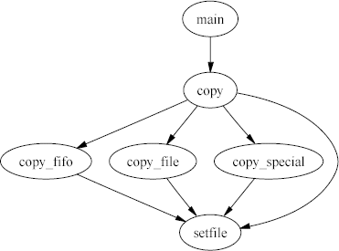
Graphical IR
Graph
Call Graph
To represent the runtime transfers of control between procedures, compilers use a call graph.
A call graph has a node for each procedure and an edge for each distinct procedure call site. Thus, the code calls q from three textually distinct sites in p; the call graph has three edges (p, q), one for each call site.
Example
To address inefficiencies that arise in procedure level, compilers perform interprocedural and intraprocedural analysis and optimization.

Slide 36
Linear IR
The alternative to a graphical IR is a linear IR.
An assembly-language program is a form of linear code.
It consists of a sequence of instructions that execute in their order of appearance
The linear IRs used in compilers resemble the assembly code for an abstract machine.
Many kinds of linear IRs have been used in compilers.
One-address codes model the behavior of accumulator machines and stack machines.
(2) Two-address codes model a machine that has destructive operations.
(3) Three-address codes model a machine where most operations take two operands and produce a result
Two linear IRs will be discussed stack-machine code (a one address code) and three-address code.

Slide 38
Linear IR
Stack-Machine Code
Stack-machine code, a form of one-address code, assumes the presence of a stack of operands.
Most operations take their operands from the stack and push their results back onto the stack.
For example, an integer subtract operation would remove the top two elements from the stack and push their difference onto the stack.
Stack-machine code for the expression a - 2 × b appears in the margin.
Stack-machine code is compact.
The stack creates an implicit name space and eliminates many names from the IR. This shrinks the size of a program in IR form.

Slide 39
Linear IR
Three-Address code
In three-address code most operations have the form i ← j op k, with an operator (op), two operands (j and k) and one result (i).
Some operators, such as an immediate load and a jump, will need fewer arguments.
Sometimes, an operation with more than three addresses is needed.
Three address code for a - 2 × b appears in the margin.
ILOC is another example of a three-address code.
Three-address code is attractive for several reasons
It is compact - Most operations consist of four items: an operation and three names.
Separate names for the operands and the target give the compiler freedom to control the reuse of names and values.
(3) Since many modern processors implement three-address operations, a three-address code models their properties well.

Slide 41
Linear IR
Representing Linear IR
Many data structures have been used to implement linear IRs.
Three-address codes are often implemented as a set of quadruples.
Each quadruple is represented with four fields: an operator, two operands (or sources), and a destination.
To form blocks, the compiler needs a mechanism to connect individual quadruples.
Compilers implement quadruples in a variety of ways.
The quadruple

Slide 42
Linear IR
Representing Linear IR
Figure 5.5 shows three different schemes for implementing the three address code for a - 2 × b.
The simplest scheme, in Figure 5.5a, uses a short array to represent each basic block. In CFG, an array is kept inside a node.
The scheme in Figure 5.5b uses an array of pointers to group quadruples into a block; the pointer array can be contained in a CFG node.
The final scheme, in Figure 5.5c, links the quadruples together to form a list.

Slide 44
Linear IR
Building a Control-Flow Graph from a Linear Code
Compilers often must convert between different IRs.
One routine conversion is to build a CFG from a linear IR such as ILOC.
The essential features of a CFGs are that it identifies the beginning and end of each basic block and connects the resulting blocks with edges that describe the possible transfers of control among blocks.
Often, the compiler must build a CFG from a simple, linear IR that represents a procedure.

Slide 45
Linear IR
Building a Control-Flow Graph from a Linear Code
As a first step, the compiler must find the beginning and the end of each basic block in the linear IR.
We will call the initial operation of a block a leader.
An operation is a leader if it is the first operation in the procedure, or if it has a label that is, potentially, the target of some branch.
The compiler can identify leaders in a single pass over the IR, shown in Figure 5.6a.
It iterates over the operations in the program, in order, finds the labelled statements, and records them as leaders.
The second pass, shown in Figure 5.6b, finds every block-ending operation.
It assumes that every block ends with a branch or a jump and that branches specify labels for both outcomes—a “branch taken” label and a “branch not taken” label.

Slide 46
Linear IR
Building a Control-Flow Graph from a Linear Code
To find the end of each block, the algorithm iterates through the blocks, in order of their appearance in the Leader array.
It walks forward through the IR until it finds the leader of the next block.
The operation immediately before that leader ends the current block.
The algorithm records that operation’s index in Last[i], so that the pair (Leader[i],Last[i]) describes block i.
It adds edges to the CFG as needed.

Slide 47
Intermediate Representation - IR
(1) Graph IR
(a) Syntax-Related Trees
Parse Trees,
Abstract Syntax Trees,
Direct Acyclic Graphs.
(b) Graphs
(1) Control flow graphs,
(2) Dependency graph,
(3) Call graph
(2) Linear IR
(1) Stack Machine code
(2) Three Address code
(3) Representing Linear IR
(4) Conversion between IR

Slide 49
Mapping values to name
The scheme that the compiler uses to assign internal names to the various values computed during execution has an effect on the code that it can generate.
The compiler must invent names for many, if not all, of the intermediate results that the program produces when it executes.
Example
a - 2 × b

Slide 51
Mapping values to name
Naming temporary values
The IR form of a program usually contains more detail than does the source version.
Some of those details are implicit in the source code; others result from deliberate choices in the translation.
To see this, consider the four-line block of source code shown in Figure 5.7a.
Assume that the names refer to distinct values.
The block deals with just four names, { a, b, c, d }.
It refers to more than four values.
Each of b, c, and d have a value before the first statement executes.
The first statement computes a new value, b + c, the second one a – d, the third one computes b + c (which is different from earlier b + c), the last one computes a – d (which is identical to the previous a - d).

Slide 52
Mapping values to name
Naming temporary values
The source code names tell the compiler little about the values that they hold.
For example, the use of b in the first and third statements refer to distinct values.
The reuse of the name b conveys no information; in fact, it might mislead a casual reader into thinking that the code sets a and c to the same value.
When the compiler names each of these expressions, it can chose names in ways that specifically encode useful information about their values.
Consider, for example, the translations shown in Figures 5.7b and 5.7c.
These two variants were generated with different naming disciplines.

Slide 53
Mapping values to name
Naming temporary values
The code in Figure 5.7b uses fewer names than the code in 5.7c.
5.7b follows the source code names, so that a reader can easily relate the code back to the code in Figure 5.7a.
The code in Figure 5.7c uses more names than the code in 5.7b. Its naming discipline reflects the computed values and ensures that textually identical expressions produce the same result.
5.7c scheme makes it obvious that a and c may receive different values, while b and d must receive the same value.

Slide 54
Mapping values to name
Naming temporary values
Another example - the representation of an array reference, A[i,j].
Figure 5.8 shows two IR fragments that represent the same computation at very different levels of abstraction.
The high-level IR, in Figure 5.8a, contains all the essential information and is easy to identify as a subscript reference.
The low-level IR, in Figure 5.8b, exposes many details to the compiler that are implicit in the high-level AST fragment.
All of the details in the low-level IR can be inferred from the source-level AST.
Address of A[i,j] =StartAddress + ((i-1)*10 + (j-1))*4

Slide 56
Mapping values to name
Static Single Assignment form
Static single-assignment form (SSA) is a naming discipline that many modern compilers use to encode information about both the flow of control and the flow of data values in the program.
In SSA form, names correspond uniquely to specific definition points in the code; each name is defined by one operation, hence the name static single assignment.

Slide 57
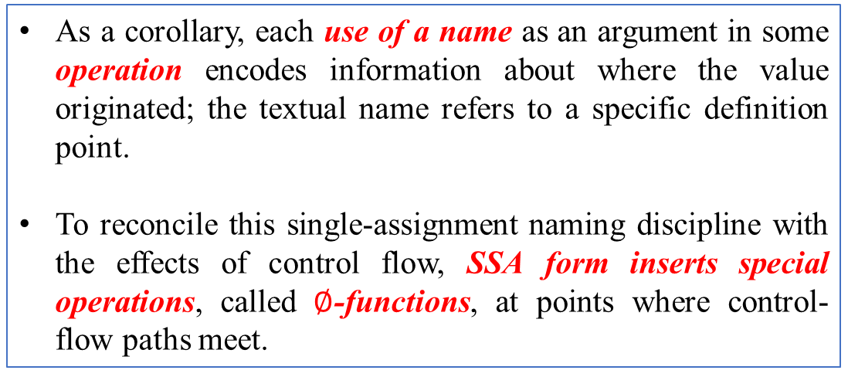
Mapping values to name
Static Single Assignment form
As a corollary, each use of a name as an argument in some operation encodes information about where the value originated; the textual name refers to a specific definition point.
To reconcile this single-assignment naming discipline with the effects of control flow, SSA form inserts special operations, called $∅$-functions, at points where control-flow paths meet.

Slide 58
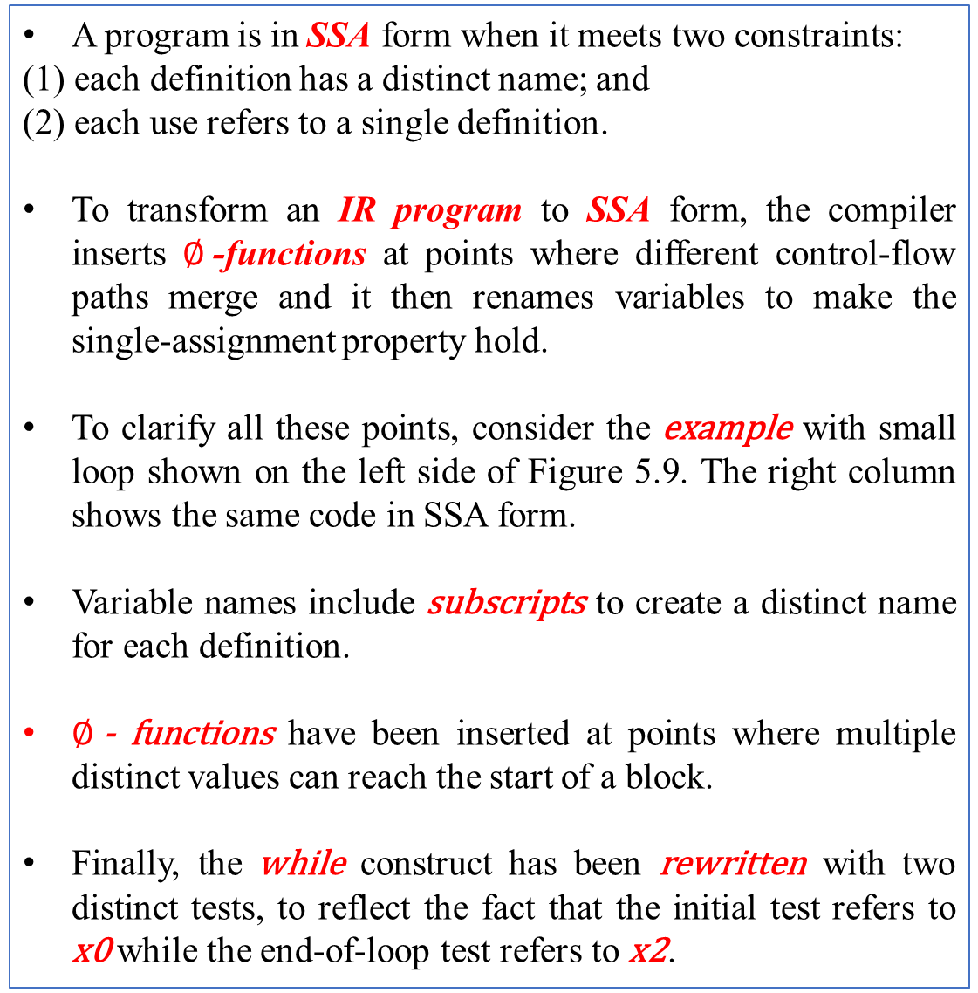
Mapping values to name
A program is in SSA form when it meets two constraints:
(1) each definition has a distinct name; and
(2) each use refers to a single definition.
To transform an IR program to SSA form, the compiler inserts $∅$-functions at points where different control-flow paths merge and it then renames variables to make the single-assignment property hold.
To clarify all these points, consider the example with small loop shown on the left side of Figure 5.9. The right column shows the same code in SSA form.
Variable names include subscripts to create a distinct name for each definition.
$∅$- functions have been inserted at points where multiple distinct values can reach the start of a block.
Finally, the while construct has been rewritten with two distinct tests, to reflect the fact that the initial test refers to x0 while the end-of-loop test refers to x2.
Static Single Assignment form

Slide 59
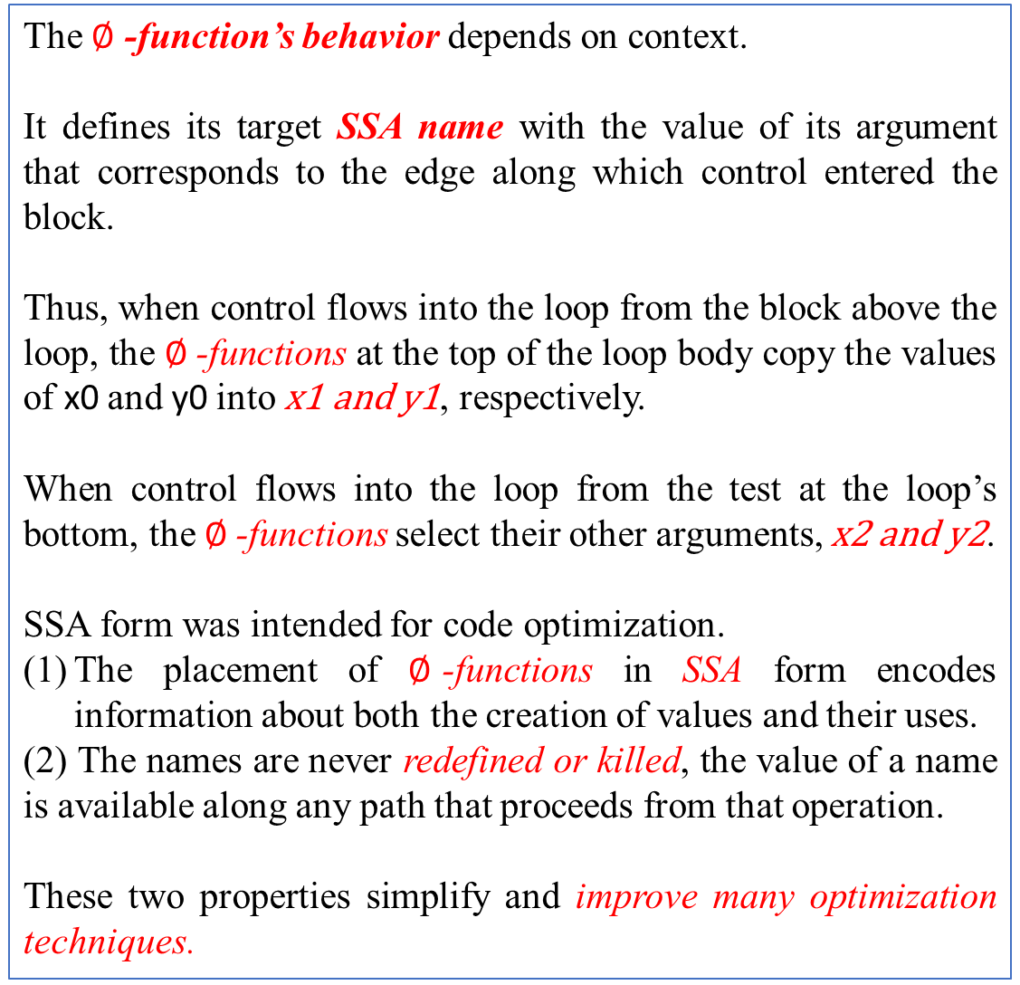
Mapping values to name
The $∅$ -function’s behavior depends on context.
It defines its target SSA name with the value of its argument that corresponds to the edge along which control entered the block.
Thus, when control flows into the loop from the block above the loop, the $∅$-functions at the top of the loop body copy the values of x0 and y0 into x1 and y1, respectively.
When control flows into the loop from the test at the loop’s bottom, the $∅$-functions select their other arguments, x2 and y2.
SSA form was intended for code optimization.
The placement of $∅$-functions in SSA form encodes information about both the creation of values and their uses.
(2) The names are never redefined or killed, the value of a name is available along any path that proceeds from that operation.
These two properties simplify and improve many optimization techniques.
Static Single Assignment form

Slide 61
Mapping values to name
Memory Models
Similar to the mechanisms for naming temporary values, Compiler has choices of storage locations for each value.
The compiler must determine, for each value computed in the code, where that value will reside.
Compiler uses Register or Memory
Eg. For a value compiler can assign r13 or 16 bytes from the label L0089.

Slide 62
Mapping values to name
Memory Models
Compilers work from one of two memory models
(1) Register-to-Register Model and
(2) Memory-to-Memory Model
Register-to-Register Model
the compiler keeps values in registers.
any value that can legally be kept in a register for most of its lifetime is kept in a register.
any value that cannot be kept in a register for most of its lifetime is stored in memory.
the compiler generates code to store its value each time it is computed and to load its value at each use.
Memory-to-Memory Model
- under this model, the compiler assumes that all values are kept in memory locations.
- the values move from memory to a register just before they are used, values move from a register to
memory just after they are defined.
- the number of registers named in the IR version of the code is small compared to the register-to-register model.

Slide 63
Intermediate Representation - IR
Naming Schemes
(1) Graph IR
(a) Syntax-Related Trees
Parse Trees,
Abstract Syntax Trees,
Direct Acyclic Graphs.
(b) Graphs
(1) Control flow graphs,
(2) Dependency graph,
(3) Call graph
(2) Linear IR
(1) Stack Machine code
(2) Three Address code
(3) Representing Linear IR
(4) Conversion between IR
(1) Naming Schemes
(2) SSA – Static Single Assignment
For problem samples –
Refer to the PPT titled ‘chapter-5-IR’,s stored in from_Mentor/for_Term3 folder.

Slide 65
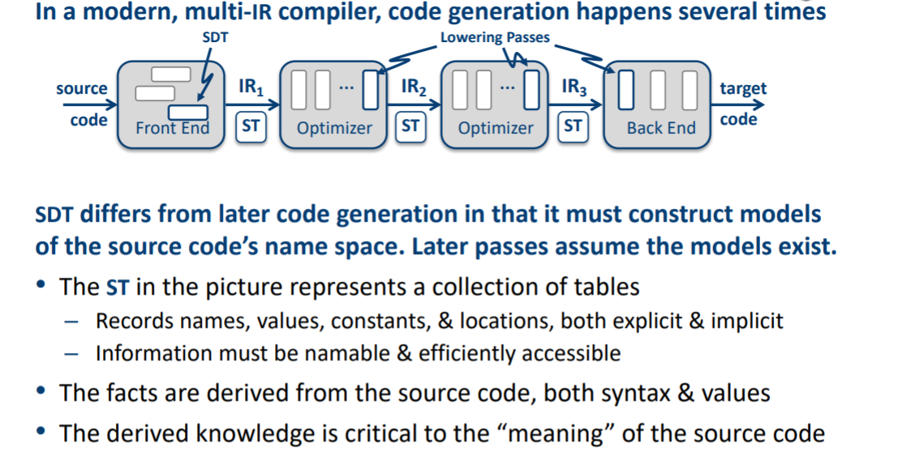
What is a Symbol Table(ST)?
Symbol Tables

Slide 66
Symbol Tables
As part of translation, a compiler derives information about the various entities manipulated by the program being translated.
It must discover and store many distinct kinds of information.
It encounters a wide variety of names — variables, defined constants, procedures, functions, labels, structures, and files.
As discussed in the previous section, the compiler also generates many names.

Slide 67
Recording Names
Symbol Tables
Recording names in AST built by parser
information about variables are stored as annotations.
Adv: uses a single representation for the code being compiled.
Disadv: Navigating AST to find declaration is costly.
Alternate is central repository -Symbol table
It reduces searching cost.
It eliminates the overhead of making each reference contain a pointer to the declaration.

Slide 68
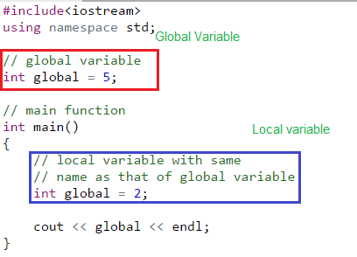
Scope of the names
Symbol Tables
Suppose that a name is used many times for different entities in text of the program, or in the course of execution.
When the name is used, to which of these entities does it refer?

Slide 69
Scope and visibility
Symbol Tables
Scope (visibility) of identifier = portion of program where identifier can be referred to.
Lexical scope = textual region in the program
Statement block
Method body
Class body
Module / package / file
Whole program (multiple modules)

Slide 70
Lexical scoping in block structured language
Symbol Tables
Each scope (procedure or block) creates its own name space
Any name can be declared locally
Local names obscure identical non-local names
Local names cannot be seen outside the scope
Scopes are searched in the order that they were encountered
Algol and Pascal are the classic examples – Nested procedures, often with deep nesting
Fortran had local, static, and named global scopes
C has global, static, local, and block scopes
begin int x;
begin real x;
begin
y:=x;
end
end
end

Slide 71
Symbol tables in block-structured languages
Symbol Tables
Many small tables - one symbol table per scope.
One global table - All names are in the same table.
What about the same name is declared several times?
Each name is given a scope number/level.
<name, level> should be unique in the table.

Slide 72
Types of Symbol Tables
Symbol Tables
Proposed Implementation of lexically scoped symbol table
Stack
Sheaf-of-Tables
Open Hashing
Open Hashing + stack
Open Addressing
Two dimensional Hashed symbol Table.
Notes:
A compiler uses a symbol table to keep track of scope and binding information about names. It is filled after the AST is made by walking through the tree, discovering and assimilating information about the names. There should be two basic operations – to insert a new name or information into the symbol table as and when discovered and to efficiently lookup a name in the symbol table to retrieve its information.
Two common data structures used for the symbol table are –
Linear lists:- simple to implement, poor performance
Hash tables:- greater programming/space overhead, good performance
Ideally a compiler should be able to grow the symbol table dynamically, i.e. insert new entries or information as and when needed. But if the size of the table is fixed in advance then ( an array implementation for example), then the size must be big enough in advance to accommodate the largest possible program.

Slide 73
Example- Nested scoping
Symbol Tables
procedure p {
int a, b, c
procedure q {
int v, b, x, w
procedure r {
int x, y, z
….
}
procedure s {
int x, a, v
…
}
… r … s
}
… q …
}
B0: {
int a, b, c
B1: {
int v, b, x, w
B2: {
int x, y, z
….
}
B3: {
int x, a, v
…
}
…
}
…
}

Slide 74
Implementing Lexically Scoped Symbol Tables- Stack organization
Symbol Tables
Implementation
insert () creates new level pointer if needed and inserts at nextFree.
lookup () searches linearly from
nextFree –1 forward.
delete () sets nextFree to the equal the start location of the level deleted.
Advantage
Uses much less space
Disadvantage
Lookups can be expensive
growth
B0: {
int a, b, c
B1: {
int v, b, x, w
B2: {
int x, y, z
….
}
B3: {
int x, a, v
…
}
…
}
…
}
nextFree
z
y
r (level 2)
x
w
x
b
q (level 1)
v
c
b
p (level 0)
a

Slide 75
Types of Symbol Table
Symbol Tables
Proposed Implementation of lexically scoped symbol table
Stack
Sheaf-of-Tables
Open Hashing
Open Hashing + stack
Open Addressing
Two dimensional Hashed symbol Table
Notes:
A compiler uses a symbol table to keep track of scope and binding information about names. It is filled after the AST is made by walking through the tree, discovering and assimilating information about the names. There should be two basic operations – to insert a new name or information into the symbol table as and when discovered and to efficiently lookup a name in the symbol table to retrieve its information.
Two common data structures used for the symbol table are –
Linear lists:- simple to implement, poor performance
Hash tables:- greater programming/space overhead, good performance
Ideally a compiler should be able to grow the symbol table dynamically, i.e. insert new entries or information as and when needed. But if the size of the table is fixed in advance then ( an array implementation for example), then the size must be big enough in advance to accommodate the largest possible program.

Slide 76
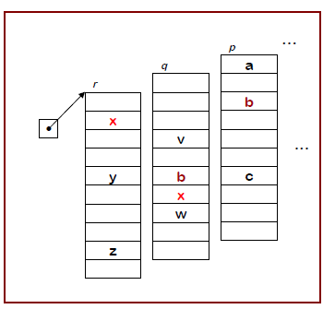
Implementing Lexically Scoped Symbol Tables- Dynamic Sheaf-of -Tables
Symbol Tables
Create a new table for each scope
Chain them together for lookup
“Sheaf of tables” implementation
insert() may need to create table, it always inserts at current level.
lookup() walks chain of tables & returns first occurrence of name.
delete() throws away table for level p, if it is top table in the chain.
If the compiler must preserve the table (for, say, the debugger ), this idea is actually practical.
Individual tables can be hash tables.
B0: {
int a, b, c
B1: {
int v, b, x, w
B2: {
int x, y, z
….
}
B3: {
int x, a, v
…
}
…
}
…
}

Slide 77
Dynamic Sheaf-of -Tables
Symbol Tables
B0: {
int a, b, c
B1: {
int v, b, x, w
B2: {
int x, y, z
….
}
B3: {
int x, a, v
…
}
…
}
…
}
Final table
p
s
q
a
b
c
r
v
b
x
w
x
a
v
.
x
y
z

Slide 78
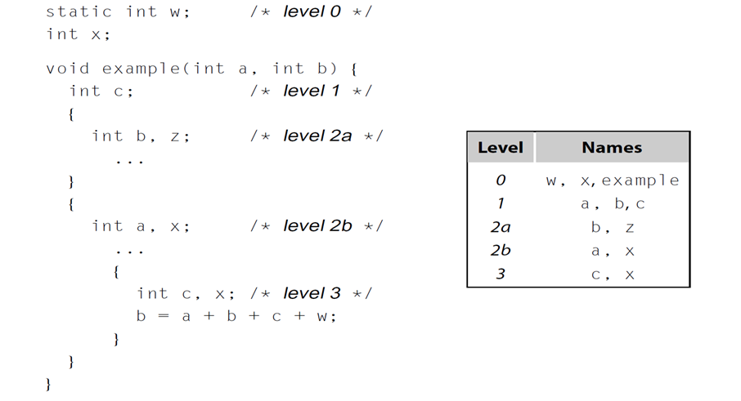
Dynamic Sheaf-of –Tables Example-2
Symbol Tables

Slide 79
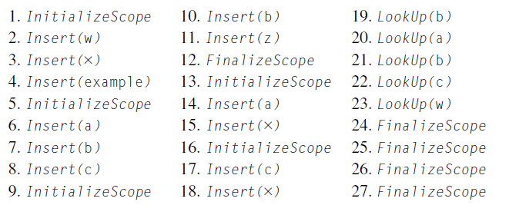
Implementing Lexically Scoped Symbol Tables- Dynamic Sheaf-of -Tables
Symbol Tables
Sequence of calls

Slide 80
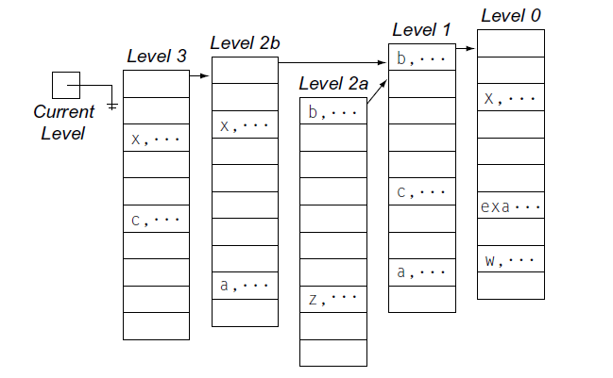
Implementing Lexically Scoped Symbol Tables- Dynamic Sheaf-of -Tables
Symbol Tables
Final table

Slide 81
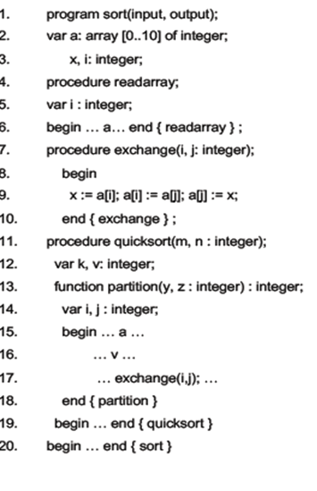
Implementing Lexically Scoped Symbol Tables- Static Sheaf-of -Tables
Symbol Tables

Slide 82
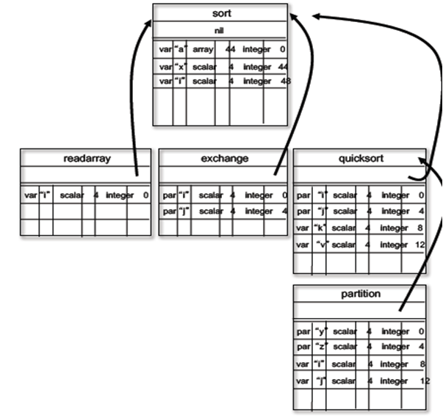
Symbol Tables

Slide 83
Types of Symbol Table
Symbol Tables
Proposed Implementation of lexically scoped symbol table
Stack
Sheaf-of-Tables
Open Hashing
Open Hashing + stack
Open Addressing
Two dimensional Hashed symbol Table
Notes:
A compiler uses a symbol table to keep track of scope and binding information about names. It is filled after the AST is made by walking through the tree, discovering and assimilating information about the names. There should be two basic operations – to insert a new name or information into the symbol table as and when discovered and to efficiently lookup a name in the symbol table to retrieve its information.
Two common data structures used for the symbol table are –
Linear lists:- simple to implement, poor performance
Hash tables:- greater programming/space overhead, good performance
Ideally a compiler should be able to grow the symbol table dynamically, i.e. insert new entries or information as and when needed. But if the size of the table is fixed in advance then ( an array implementation for example), then the size must be big enough in advance to accommodate the largest possible program.

Slide 84
Implementing Lexically Scoped Symbol Tables- Open Hashing
Symbol Tables

Slide 85
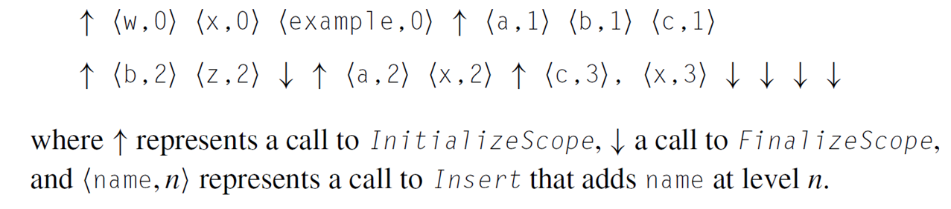
Implementing Lexically Scoped Symbol Tables- Open Hashing
Symbol Tables
Actions Generated for the code

Slide 86
Implementing Lexically Scoped Symbol Tables- Open Hashing
Symbol Tables
Insert
Checks for duplicates for each name (by comparing name and level) and inserts in the front of the chain
Lookup
Returns the first record discovered for a given name
Initialize scope
Puts a counter for the current lexical level
Finalize scope
Must decrement the current lexical level
Find and Remove all the records for any names inserted in the scope being deallocated or
Chain them together to preserve them

Slide 87
Implementing Lexically Scoped Symbol Tables- Open Hashing
Symbol Tables
Here, the finalizescope has deallocated the records of level 2a before entering into level 2b.
However, if required the level 2a can be preserved before entering level 2b.

Slide 88
Symbol Table
Symbol Tables
Proposed Implementation of lexically scoped symbol table
Stack
Sheaf-of-Tables
Open Hashing
Open Hashing + stack
Open Addressing
Two dimensional Hashed symbol Table
Notes:
A compiler uses a symbol table to keep track of scope and binding information about names. It is filled after the AST is made by walking through the tree, discovering and assimilating information about the names. There should be two basic operations – to insert a new name or information into the symbol table as and when discovered and to efficiently lookup a name in the symbol table to retrieve its information.
Two common data structures used for the symbol table are –
Linear lists:- simple to implement, poor performance
Hash tables:- greater programming/space overhead, good performance
Ideally a compiler should be able to grow the symbol table dynamically, i.e. insert new entries or information as and when needed. But if the size of the table is fixed in advance then ( an array implementation for example), then the size must be big enough in advance to accommodate the largest possible program.

Slide 89
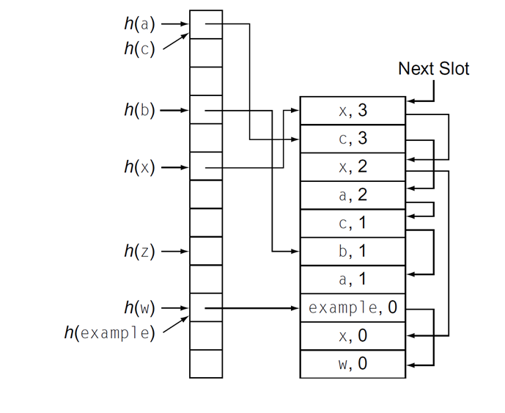
Implementing Lexically Scoped Symbol Tables- Open Hashing + Stack
Symbol Tables
Insert
creates new level pointer if needed and inserts at nextFree
For every hash value, inserts in the next free slot and update the chain.
Lookup
Returns the first record discovered for a given name
Initialize scope
Puts a counter for the current lexical level
FinalizeScope
Iterates from top of the stack downwards to a level below the level being discarded
Updates the index – set entry (Sets records pointer to next item in the chain)
If records are discarded resets the pointer to next available slot or the records are preserved together on the stack preserve them

Slide 90
Symbol Table
Symbol Tables
Proposed Implementation of lexically scoped symbol table
Stack
Sheaf-of-Tables
Open Hashing
Open Hashing + stack
Open Addressing + stack
Two dimensional Hashed symbol Table
Notes:
A compiler uses a symbol table to keep track of scope and binding information about names. It is filled after the AST is made by walking through the tree, discovering and assimilating information about the names. There should be two basic operations – to insert a new name or information into the symbol table as and when discovered and to efficiently lookup a name in the symbol table to retrieve its information.
Two common data structures used for the symbol table are –
Linear lists:- simple to implement, poor performance
Hash tables:- greater programming/space overhead, good performance
Ideally a compiler should be able to grow the symbol table dynamically, i.e. insert new entries or information as and when needed. But if the size of the table is fixed in advance then ( an array implementation for example), then the size must be big enough in advance to accommodate the largest possible program.

Slide 91
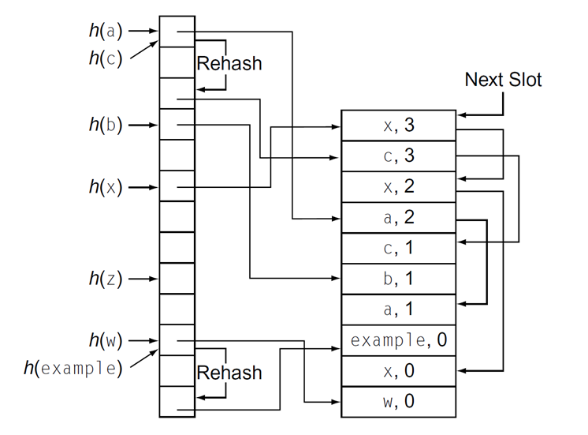
Implementing Lexically Scoped Symbol Tables- Open Addressing + stack
Symbol Tables

Slide 92
Implementing Lexically Scoped Symbol Tables- Open Addressing + stack
Symbol Tables
Insert
Creates a new record on top of stack
If older reference found, replaces the reference to the new record and links the old reference to the new record
Collisions
Creates separate chain for collisions and redeclarations
Collisions are threaded through the index set
Redeclarations are threaded through the stack (Reduces the cost of lookup as more than one record need not be examined at a time
FinalizeScope
Iterates over the top of stack (as in open hashing)
To remove a record, updates the pointer to the older variant (if exists)
To remove a final variant, inserts a reference to a designated deleted reference record
Lookup must recognize the deleted reference occupying a slot in the current chain
Insert must know if it can replace a deleted reference with a new symbol (reuse)

Slide 93
Open hashing vs open addressing
Symbol Tables
Consider a bucket in open hashing with seven declarations for x and one declaration for y
In open hashing Lookup encounters 7 x’s before finding y
In open addressing Lookup encounters one record each for x and y

Slide 94
Symbol Table
Symbol Tables
Proposed Implementation of lexically scoped symbol table
Stack
Sheaf-of-Tables
Open Hashing
Open Hashing + stack
Open Addressing
Two dimensional Hashed symbol Table
Notes:
A compiler uses a symbol table to keep track of scope and binding information about names. It is filled after the AST is made by walking through the tree, discovering and assimilating information about the names. There should be two basic operations – to insert a new name or information into the symbol table as and when discovered and to efficiently lookup a name in the symbol table to retrieve its information.
Two common data structures used for the symbol table are –
Linear lists:- simple to implement, poor performance
Hash tables:- greater programming/space overhead, good performance
Ideally a compiler should be able to grow the symbol table dynamically, i.e. insert new entries or information as and when needed. But if the size of the table is fixed in advance then ( an array implementation for example), then the size must be big enough in advance to accommodate the largest possible program.

Slide 95
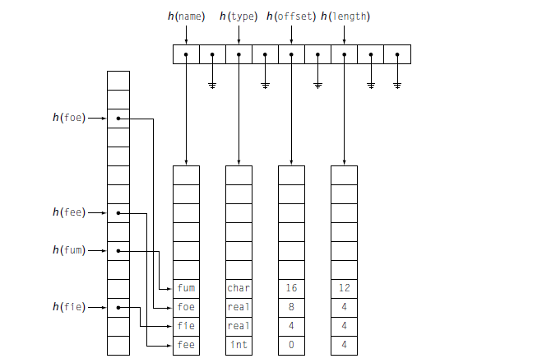
Implementing Lexically Scoped Symbol Tables- Two Dimensional Hashed Symbol Table
Symbol Tables

Slide 96
The end of Chapter 5
IR
Naming
Symbol Table

